Slide 1



IBM
Skills Academy
Big Data Overview

Slide 2
Agenda
Introduction to Big Data
Growth of Interconnected Devices
Examples of Big Data
Types of Big Data
Big Data in the Industry
Big Data in Healthcare (use cases)
Big Data in Finance (use cases)
Big Data in Telecommunication (use cases)
Big Data in Retail and Social Media (use cases)
Big Data in Manufacurting (use cases)
Big Data and Internet of Things

Slide 3
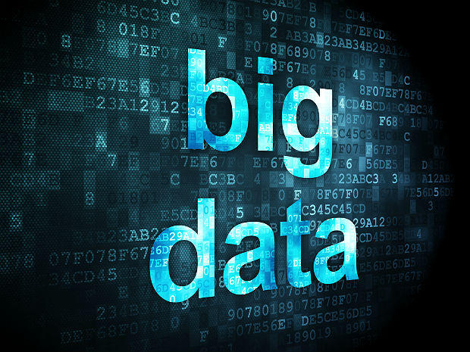
Introduction to Big Data
A tsunami of Big Data
The Vs of Big Data (3Vs, 4Vs, 5Vs, …)
The count depends on who does the counting
The Ecosystem
Apache open Source
The distributions
The add-ons
Open Data Platform Initiative (OPDi.org)
Some basic terminology

Slide 4
Big Data - a tsunami that is hitting us already
We are witnessing a tsunami of data:
Huge volumes
Data of different types and formats
Impacting the business at new and ever increasing speeds
The challenges:
Capturing, transporting, and moving the data
Managing - the data, the hardware involved, and the software (open source and not)
Processing - from munging the raw data to programming to provide insight into the data
Storing - safeguarding and securing
“Big Data refers to non-conventional strategies and innovative technologies used by businesses and organizations to capture, manage, process, and make sense of a large volume of data”
The industries involved
The futures
Notes:
We are witnessing a tsunami of huge volume of data of different types and formats that make managing, processing, storing safeguarding and securing, and transporting them a real challenge.
Big Data refers to non-conventional strategies and innovative technologies used by businesses and organizations to capture, manage, process, and make sense of a large volume of data. Ref.: Jeff Reed (2017), Data Analytics: Applicable Data Analysis to Advance Any Business Using the Power of Data Driven Analytics
The analogies:
Elephant (hence the logo of Hadoop)
Humongous (the underlying word for Mongo Database)
Streams, data lakes, oceans of data

Slide 5
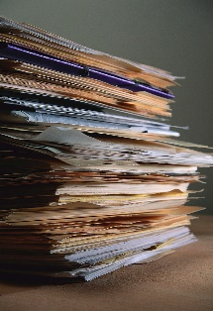
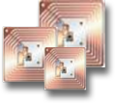
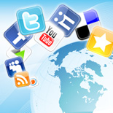
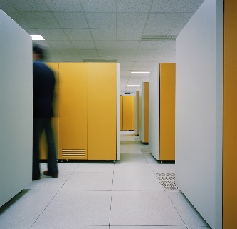

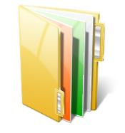
Data has an intrinsic property…it grows and grows
90%
of the world’s data was created in the last two years
80%
of the world’s data today is unstructured
20%
of available data can be processed by traditional systems
1 in 2
business leaders don’t have access to data they need
83%
of CIO’s cited BI and analytics as part of their visionary plan
5.4X
more likely that top performers use business analytics

Slide 6
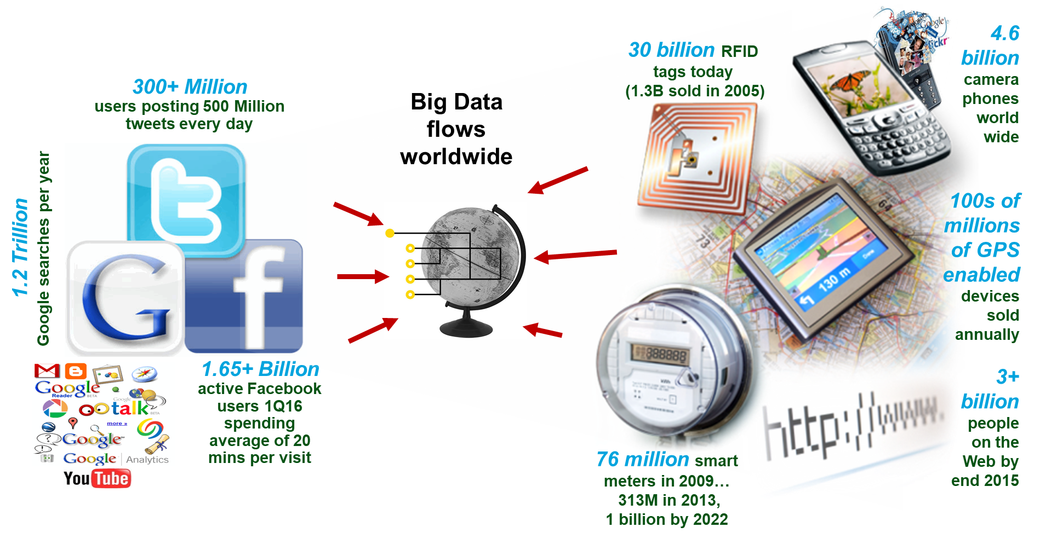
Growing interconnected & instrumented world
Notes:
Gary’s Social Media Count - webpage - http://www.personalizemedia.com/garys-social-media-count/
Passive RFID grows by 1.12 billion tags in 2014 to 6.9 billion: More than five years later than the industry had expected, market research and events firm IDTechEx find that the passive RFID tag market is now seeing tremendous volume growth.
- http://www.idtechex.com/research/articles/passive-rfid-grows-by-1-12-billion-tags-in-2014-to-6-9-billion-00007031.asp
- http://www.statista.com/statistics/299966/size-of-the-global-rfid-market/
- https://en.wikipedia.org/wiki/Radio-frequency_identification
It is Predicted This Year That 1.3 Billion RFID Tags Will Be Sold (in 2006), but This Number is Expected to Grow Rapidly over the Next Ten Years
- http://www.businesswire.com/news/home/20060124005042/en/Predicted-Year-1.3-Billion-RFID-Tags-Sold
The number of internet users has increased tenfold from 1999 to 2013. The first billion was reached in 2005. The second billion in 2010. The third billion in 2014.
- http://www.internetlivestats.com/internet-users/
Growth in the smart electric meter market has cooled during the last year, even though strong market drivers remain in place on which utilities can build a business case. Although the direct operational and societal benefits of smart meters and the broader benefits of smart grids that are enabled by smart meters continue to be debated among policymakers, utilities, regulators, and consumers, penetration rates continue to climb, reaching nearly 39 percent in North America in 2012. According to a recent report from Navigant Research, the worldwide installed base of smart meters will grow from 313 million in 2013 to nearly 1.1 billion in 2022.
- https://www.navigantresearch.com/newsroom/the-installed-base-of-smart-meters-will-surpass-1-billion-by-2022
Number of monthly active Facebook users worldwide as of 1st quarter 2016 (in millions) - http://www.statista.com/statistics/264810/number-of-monthly-active-facebook-users-worldwide/
The Top 20 Valuable Facebook Statistics - Updated April 2016
- https://zephoria.com/top-15-valuable-facebook-statistics/
Number of mobile phones to exceed world population by 2014. The ITU expects the number of cell phone accounts to rise from 6 billion now to 7.3 billion in 2014, compared with a global population of 7 billion. Over 100 countries have the number of cell phone accounts exceeding their population.
- http://www.digitaltrends.com/mobile/mobile-phone-world-population-2014/
- http://www.siliconindia.com/magazine_articles/World_to_have_more_cell_phone_accounts_than_people_by_2014-DASD767476836.html

Slide 7
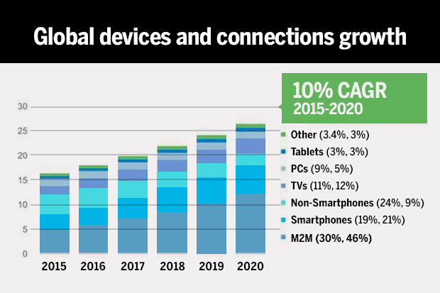
Growth in Internet traffic (PCs, smartphones, IoT,…)
Notes:
Cisco report says smartphone traffic will exceed PC traffic by 2020
IP traffic will grow in a massive way as 10 billion new devices come online over the next five years
Advancements in the Internet of Things (IoT) are continuing to drive IP traffic and tangible growth in the market
Graphic: NetworkWorld, 7 Jun 2016
Reference:
http://www.networkworld.com/article/3080001/lan-wan/cisco-ip-traffic-will-surpass-the-zettabyte-level-in-2016.html
Applications such as video surveillance, smart meters, digital health monitors and a host of other Machine-to-Machine services are creating new network requirements and incremental traffic increases.
Annual global IP traffic will surpass the zettabyte (ZB; 1000 exabytes) threshold in 2016, and will reach 2.3 ZB by 2020. Global IP traffic will reach 1.1 ZB per year or 88.7 EB (one billion gigabytes [GB]) per month in 2016. By 2020, global IP traffic will reach 2.3 ZB per year, or 194 EB per month.
The number of devices connected to IP networks will be three times as high as the global population in 2020. There will be 3.4 networked devices per capita by 2020, up from 2.2 networked devices per capita in 2015. Accelerated in part by the increase in devices and the capabilities of those devices, IP traffic per capita will reach 25 GB per capita by 2020, up from 10 GB per capita in 2015.

Slide 8
Some examples of Big Data
Science
Astronomy
Atmospheric science
Genomics
Biogeochemical
Biological
and other complex / interdisciplinary scientific research
Social
Social networks
Social data
Person to person (P2P, C2C):
Wish Lists on Amazon.com
Craig’s List
Person to world (P2W, C2W):
Twitter
Facebook
LinkedIn
Medical records
Commercial
Web / event / database logs
"Digital exhaust" - result of human interaction with the Internet
Sensor networks
RFID
Internet text and documents
Internet search indexing
Call detail records (CDR)
Photographic archives
Video / audio archives
Large scale eCommerce
Government
Regular government business and commerce needs
Military and homeland security surveillance

Slide 9

Types of Big Data
Structured
Data that can be stored and processed in a fixed format, aka schema
Semi-structured
Data that does not have a formal structure of a data model, i.e. a table definition in a relational DBMS, but nevertheless it has some organizational properties like tags and other markers to separate semantic elements that makes it easier to analyze, aka XML or JSON
Unstructured
Data that has an unknown form and cannot be stored in RDBMS and cannot be analyzed unless it is transformed into a structured format is called as unstructured data
Text Files and multimedia contents like images, audios, videos are example of unstructured data - unstructured data is growing quicker than others, experts say that 80 percent of the data in an organization is unstructured
Notes:
Structured: The data that can be stored and processed in a fixed format is called as Structured Data. Data stored in a relational database management system (RDBMS) is one example of ‘structured’ data. It is easy to process structured data as it has a fixed schema. Structured Query Language (SQL) is often used to manage such kind of Data.
Semi-Structured: Semi-Structured Data is a type of data which does not have a formal structure of a data model, i.e. a table definition in a relational DBMS, but nevertheless it has some organizational properties like tags and other markers to separate semantic elements that makes it easier to analyze. XML files or JSON documents are examples of semi-structured data.
Unstructured: The data which have unknown form and cannot be stored in RDBMS and cannot be analyzed unless it is transformed into a structured format is called as unstructured data. Text Files and multimedia contents like images, audios, videos are example of unstructured data. The unstructured data is growing quicker than others, experts say that 80 percent of the data in an organization are unstructured.

Slide 10
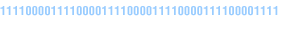
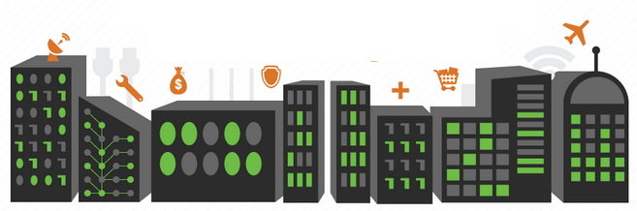
Big Data Use Cases
Healthcare
Financial
Industry
Agriculture
…and many others
Notes:
Links
Which industries benefit most from big data?
http://hortonworks.com/big-data-insights/industries-benefit-big-data
Explore new ways to work with IBM Predictive Industry Solutions
http://www.ibm.com/analytics/us/en/industry/index.html www.ibmbigdatahub.com/use-cases

Slide 11
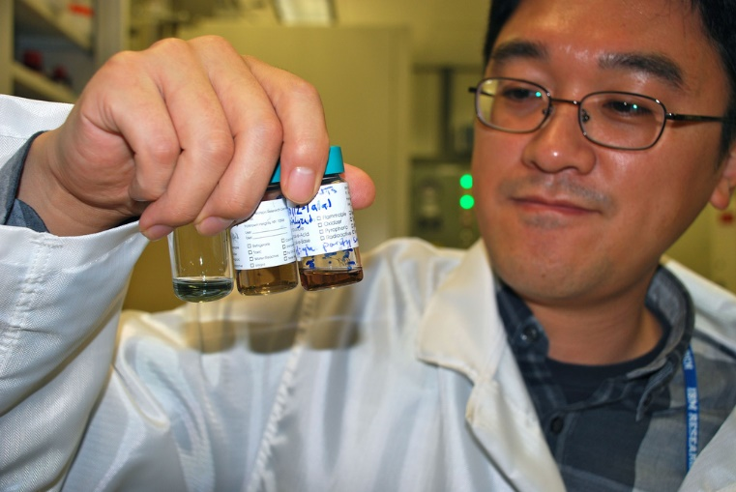
Use cases for a Big Data platform: Healthcare and Life Sciences
Problem:
Vast quantities of real-time information are starting to come from wireless monitoring devices that postoperative patients and those with chronic diseases are wearing at home and in their daily lives.
How big data analytics can help:
Epidemic early warning
Intensive Care Unit and remote monitoring

Slide 12

Healthcare
How Big Data Is Quietly Fighting Diseases and Illnesses
http://dataconomy.com/how-big-data-is-quietly-fighting-diseases-and-illnesses
The Data Is In: 3 Ways Analytics Will Improve Healthcare
http://dataconomy.com/the-data-is-in-3-ways-analytics-will-improve-healthcare

Slide 13
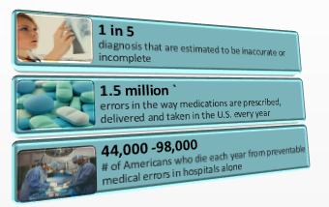
Big Data and complexity in healthcare
Medical information is doubling every 5 years, much of which is unstructured
81% of physicians report spending 5 hours or less per month reading medical journals
Notes:
“Medicine has become too complex (and only) about 20 percent of the knowledge clinicians use today is evidence-based” - Steven Shapiro, Chief Medical and Scientific Officer, UPMC
“…to keep up with the state of the art, a doctor would have to devote 160 hours a week to perusing papers …” - The Economist, Feb 14th 2013

Slide 14

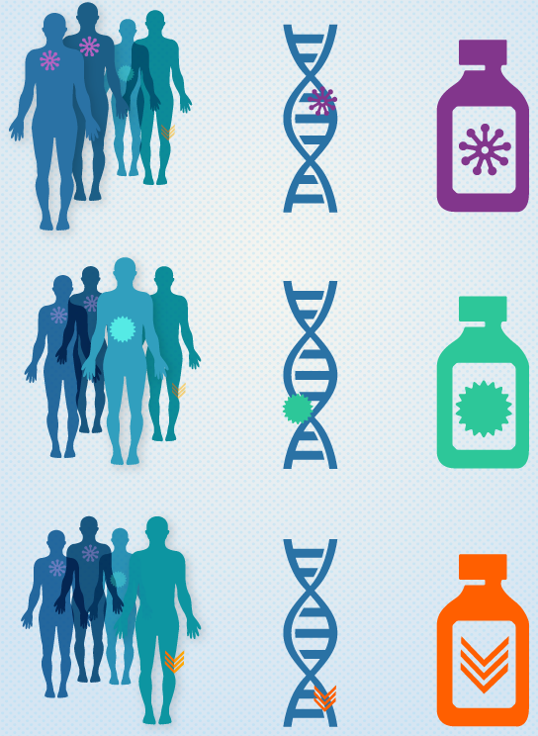
Precision Medicine Initiative (PMI) & Big Data
Precision Medicine
A medical model that proposes the customization of healthcare, with medical decisions, practices, and/or products being tailored to the individual patient - Wikipedia
Diagnostic testing is often employed for selecting appropriate and optimal therapies based on the context of a patient’s genetic content or other molecular or cellular analysis
Tools employed in PM can include molecular diagnostics, imaging, and analytics/software
The Precision Medicine Initiative (PMI)
A $215 million investment in President Obama’s Fiscal Year 2016 Budget to accelerate biomedical research and provide clinicians with new tools to select the therapies that will work best in individual patients
Notes:
Graphic on the right (from the National Cancer Institute) illustrates the use of precision medicine in cancer treatment. “Discovering unique therapies that treat an individual’s cancer base on the specific genetic abnormalities of that person’s tumor.
Precision Medicine Initiative (PMI) references:
Obama’s Precision Medicine Initiative Is The Ultimate Big-Data Project - “Curing both rare diseases and common cancers doesn't just require new research, but also linking all the data that researchers already have” http://www.fastcompany.com/3057177/obamas-precision-medicine-initiative-is-the-ultimate-big-data-project
White House https://www.whitehouse.gov/precision-medicine
Obama: Precision Medicine Initiative Is First Step to Revolutionizing Medicine - "We may be able to accelerate the process of discovering cures in ways we've never seen before," the president said http://www.usnews.com/news/articles/2016-02-25/obama-precision-medicine-initiative-is-first-step-to-revolutionizing-medicine
National Institutes of Health https://www.nih.gov/precision-medicine-initiative-cohort-program
National Cancer Institute http://www.cancer.gov/research/key-initiatives/precision-medicine
Precision Medicine (Wikipedia) https://en.wikipedia.org/wiki/Precision_medicine

Slide 15
Use cases for a Big Data platform: Financial Services
Problem:
Manage the several Petabytes of data which is growing at 40-100% per year under increasing pressure to prevent frauds and complaints to regulators
How big data analytics can help:
Fraud detection
Credit issuance
Risk management
360° view of the Customer

Slide 16
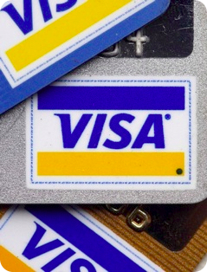
Financial marketplace example: Visa
Problem
Credit card fraud costs up to 7 cents per 100 dollars – billions of dollars per year
Fraud schemes are constantly changing
Understanding the fraud pattern months after the fact is only partially helpful - fraud detection models need to evolve faster
If only Visa could …
Reinvent how to detect the fraud patterns
Stop new fraud patterns before they can rack-up significant losses
Solution
Revolutionize the speed of detection
Visa loaded two years of test records, or 73 billion transactions, amounting to 36 terabytes of data into Hadoop - the processing time fell from one month with traditional methods to a mere 13 minutes

Slide 17
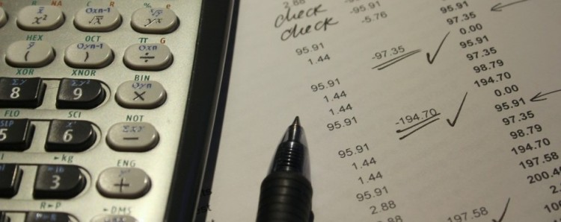
Financial
Big data is overhauling credit scores
http://dataconomy.com/big-data-overhauling-credit-scores-2
Top 10 Big Data Trends in 2016 for Financial Services
https://www.mapr.com/blog/top-10-big-data-trends-2016-financial-services

Slide 18
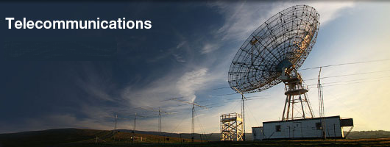
Use cases for a Big Data platform: Telecommunications Services
Problem:
Legacy systems are used to gain insights from internally generated data facing issues of high storage costs, long data loading time, and long administration processing times
How big data analytics can help:
CDR processing
Combat fraud
Churn prediction
Geomapping / marketing
Network monitoring
Notes:
Survey: 90% of telco service providers believe Hadoop is best platform to combat fraud (18 May 2016) http://www.fiercebigdata.com/story/survey-90-telco-service-providers-believe-hadoop-best-platform-combat-fraud/2016-05-18
A recently released survey by Cloudera and Argyle Data found that 90 percent of telcos believe Hadoop is the most effective platform to combat revenue fraud scams, losses from which are now estimated at U.S. $38 billion.
"Across all areas of industry, people are trying to figure out the most effective use cases for Hadoop," said Vijay Raja, solutions marketing manager at Cloudera, in the announcement.
"Fraud prevention is a textbook use case for Hadoop-based analytics because the ROI is immediately visible.“
While the two companies tout the capabilities of machine learning in tackling security issues, of which fraud is one, most applications of machine learning are not yet ready to replace human security analysts.
"Although security solutions based on unsupervised machine learning do exist, relying entirely on artificial intelligence to spot cyberattacks isn't totally practical because such systems yield a large number of false positives," explains Ben Dickson, a software engineer, in his post in The Daily Dot.
"You eventually need the help of human experts to find evidence of security breaches and make critical decisions.“
However, machine learning often proves to be an exceptional tool in leveraging human talent beyond what the human alone can do. It's simply too much data for a human to mentally process and react to fast enough to do any good.
Further, there's a major shortage in skilled cyber security analysts at the moment. That means that most companies are running big on security problems but short on talent to address it.
So, while cybersecurity pros are safely employed for the foreseeable future, any who do not use machine learning for a much-needed assist will soon find themselves replaced by those that do.
It's not a question of machine or man, but a mandate of man and machine.

Slide 19
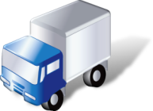
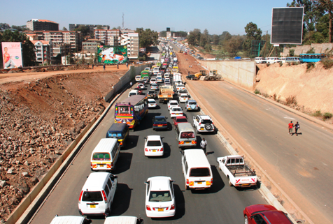
Use cases for a Big Data platform: Transportation Services
Problem:
Traffic congestion has been increasing worldwide as a result of increased urbanization and population growth reducing the efficiency of transportation infrastructure and increasing travel time and fuel consumption.
How big data analytics can help:
Urban planning & monitoring
Real time analysis to weather and traffic congestion data streams to identify traffic patterns reducing transportation costs.

Slide 20
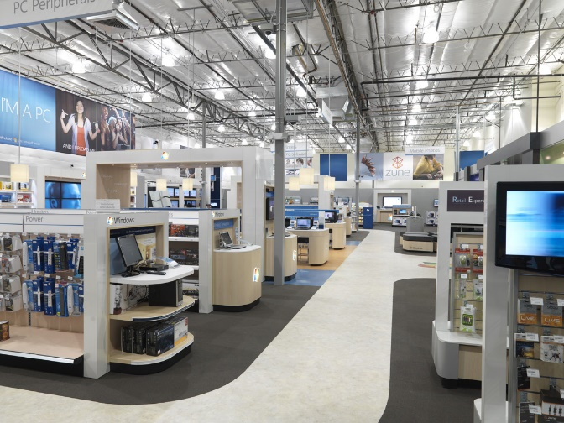
Use cases for a Big Data platform: Retailers & Social Media
Problem:
Savvy retailers want to use “big data” to predict trends, prepare for demand, pinpoint customers, optimize pricing & promotions, and monitor real-time analytics & results - by combining data from web browsing patterns, social media, industry forecasts, existing customer records, etc.
How big data analytics can help:
Access social media to gain insight
Federate data between Big Data and RDBMs
Apply graph analysis to the available data
Work to understand demand and engage customers
Notes:
IBM Presentation - Big Data in Retail: Examples in Action
http://www.ibmbigdatahub.com/presentation/big-data-retail-examples-action
http://www.ibm.com/analytics/us/en/industry/retail-analytics/
One example: Graph Analytics - http://www.ibmbigdatahub.com/blog/what-graph-analytics
A growing number of businesses and industries are finding innovative ways to apply graph analytics to a variety of use-case scenarios because it affords a unique perspective on the analysis of networked entities and their relationships. Gain an understanding of how four different types of graph. http://www.ibmbigdatahub.com/blog/what-graph-analytics
IBM Institute for Business Value (IIBV) -http://www.ibm.com/services/uk/gbs/thoughtleadership/ - Register to download the complete IBM Institute for Business Value study,

Slide 21
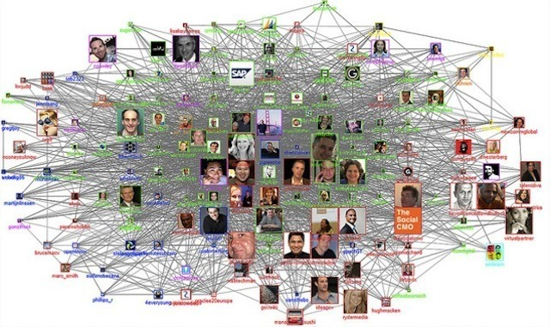
Graph analytics
Path analysis
Connectivity analysis
Community analysis
Centrality analysis
www.ibmbigdatahub.com/blog/what-graph-analytics
Notes:
Bringing this concept to the real world, nodes or vertices can be people, such as customers and employees; affinity groups such as LinkedIn or meet-up groups; and companies and institutions. They can also be places such as airports, buildings, cities and towns, distribution centers, houses, landmarks, retail stores, shipping ports and so on. Vertices can also be things such as assets, bank accounts, computer servers, customer accounts, devices, grids, molecules, policies, products, twitter handles, URLs, web pages and so on.
Edges can be elements that represent relationships such as emails, likes and dislikes, payment transactions, phone calls, social networking and so on. Edges can be directed, that is, they have a one-way direction arrow to represent a relationship from one node to another-for example, Mike made a payment to Bill; Mike follows Corinne on Twitter. They can also be non-directed-for example, M1 links London and Leeds-and weighted-for example, the number of payments between these two accounts is high. The time between two locations is also an example of a weighted relationship.
- http://www.ibmbigdatahub.com/blog/what-graph-analytics

Slide 22
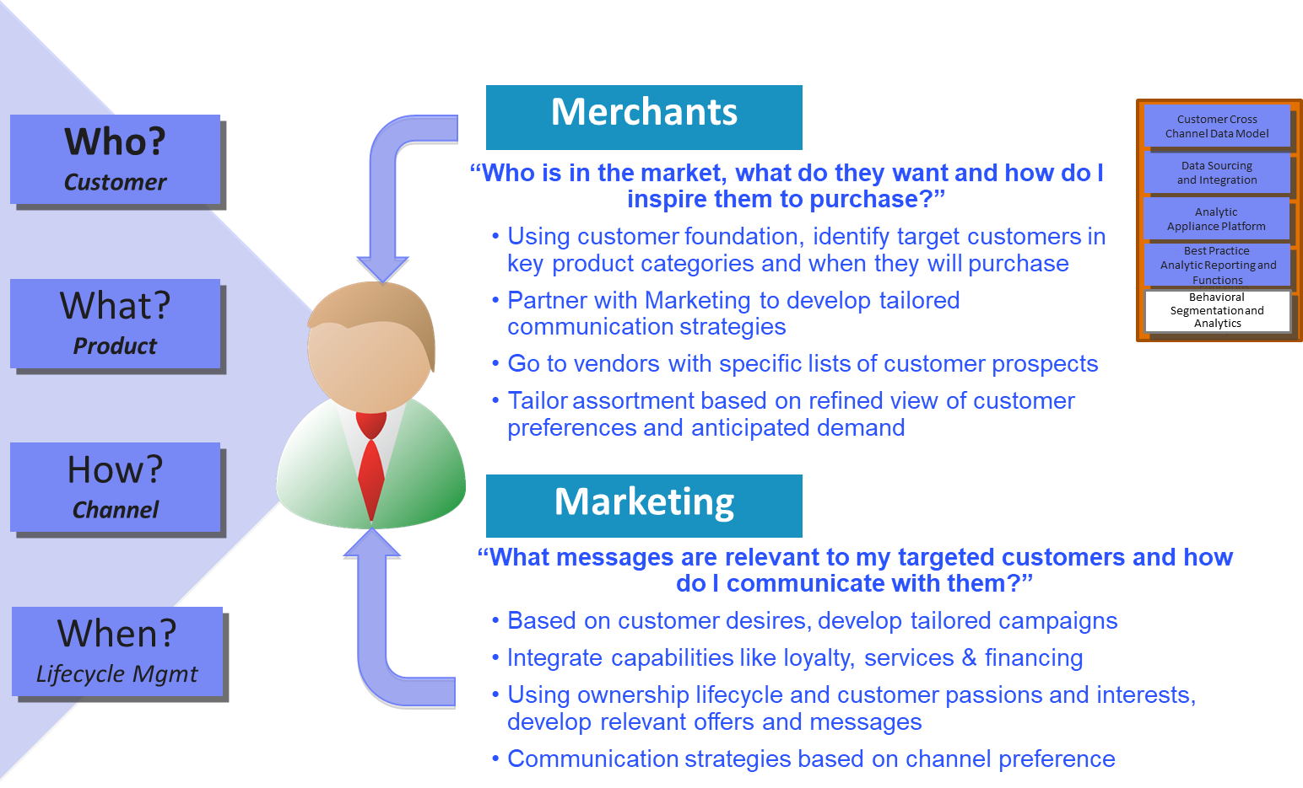
Behavioral segmentation & analytics

Slide 23

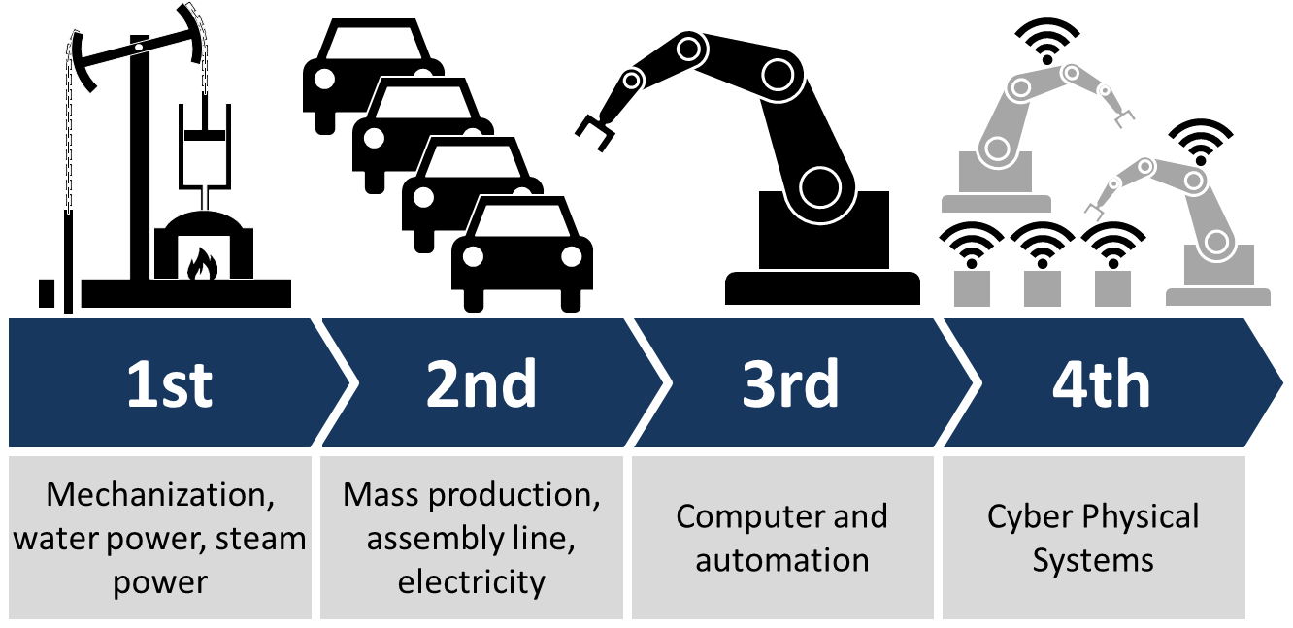
Use cases for a Big Data platform: Manufacturing
Problem:
The world of production will become more and more networked until everything is interlinked with everything else. The complexity of production and supplier networks has grow enormously. Previously, networks and processes were limited to one factory, but the boundaries of individual factories will most likely no longer exist in favor of the interconnect of multiple factories or even geographical regions..
How big data analytics can help:
The Internet of Things (IoT)
Industry 4.0
Notes:
References:
4 ways Industry 4.0 will look different in 2017 http://readwrite.com/2017/01/01/4-ways-industry-4-0-will-look-different-in-2017-il1/

Slide 24
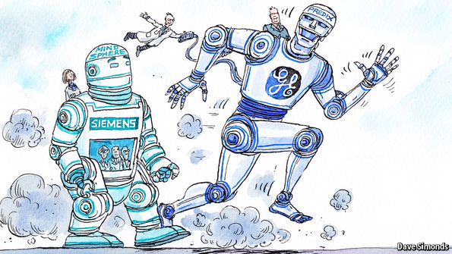
Articles on IoT - and Industry 4.0
GE & Siemens - the American industrial giant is sprinting towards its goal; the German firm is taking a more deliberate approach http://www.economist.com/news/business/21711079-american-industrial-giant-sprinting-towards-its-goal-german-firm-taking-more
Plus many more articles
And articles specific to the various industry sector

Slide 25
Data 3.0 - my view on the data landscape
The Eras of Data
0 Flat files
1 Relational Databases (RBDMs) - 1970s - OLTP (Online Transactional processing)
2 Data Warehouses - 1990s - OLAP (Online Analytical processing) or DSS (Decision Support Systems) workloads
3 Big Data - 2000s - Batch, with a movement towards Real-time
Some terminology of Big Data
Oceans of data (data at rest) vs. Streams of data (data in motion)
Data Lake (a large storage repository and processing engine)
James Dixon of Pentaho used the term initially to contrast with “data mart,” which is a smaller repository of interesting attributes extracted from the raw data. He wrote: "If you think of a datamart as a store of bottled water - cleansed and packaged and structured for easy consumption - the data lake is a large body of water in a more natural state. The contents of the data lake stream in from a source to fill the lake, and various users of the lake can come to examine, dive in, or take samples.“ (Wikipedia, Data Lake)
NoSQL (“not only SQL”)

Slide 26
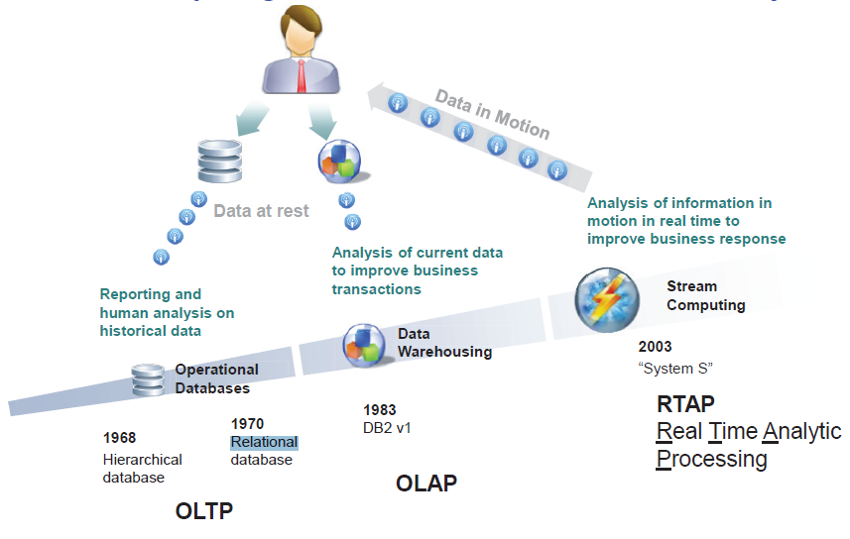
Realtime is a definite future direction for analytics
IBM System S was a precursor of the future IBM InfoSphere Streams and now the open-source competitors such as Apache Storm, Apache Kafka, etc.

Slide 27
Industry 4.0
“Industry 4.0” was the brainchild of the German government, and describes the next phase in manufacturing - a so-called fourth industrial revolution
Industry 1.0: Water/steam power
Industry 2.0: Electric power
Industry 3.0: Computing power
Industry 4:0: Internet of Things (IoT) power
Meaning
Characteristic for industrial production in an Industry 4.0 environment are the strong customization of products under the conditions of highly flexibilized (mass-) production. The required automation technology is improved by the introduction of methods of self-optimization, self-configuration, self-diagnosis, cognition and intelligent support of workers in their increasingly complex work.
Wikipedia: https://en.wikipedia.org/wiki/Industry_4.0

Slide 28
The six design principles in Industry 4.0
Interoperability
The ability of cyber-physical systems (i.e. workpiece carriers, assembly stations, and products), humans and Smart Factories to connect/communicate with each other via the Internet of Things (IoT) and the Internet of Services (IoS)
Virtualization
A virtual copy of the Smart Factory which is created by linking sensor data (from monitoring physical processes) with virtual plant models and simulation models
Decentralization
The ability of cyber-physical systems within Smart Factories to make decisions on their own
Real-time Capability
The capability to collect and analyze data and provide the derived insights immediately
Service Orientation
Offering of services (of cyber-physical systems, humans or Smart Factories) via the Internet of Services
Modularity
Flexible adaptation of Smart Factories to changing requirements by replacing or expanding individual modules

Slide 29
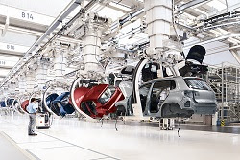
Internet of Things (IoT)
The number of connected devices that can share data is exploding, with estimates of 50-200 billion devices being connected to the Internet by 2020 - a transformative change for our industrial society
With a dramatic growth in connections:
new devices
legacy infrastructures
…triggering an unprecedented spike in data volumes, devices & data
That data represents
untapped production efficiencies
competitive business insights
new, brand-differentiating services
* but only if the data can be effectively analyzed, and its value unlocked
Photo: Siemens
Notes:
Machine-generated data is becoming a major data resource and will continue to do so. Wikibon has forecast that the market value of the industrial Internet (a term coined by Frost & Sullivan to refer to the integration of complex physical machinery with networked sensors and software) will be approximately $540 billion in 2020.
Cielen, D., Meysman, A. D. B., & Ali, M. (2016). Introducing data science: Big data, machine learning, and more, using Python tools. Shelter Island, NY: Manning Publications, p. 6.
---
http://www.datanami.com/2015/10/30/hortonworks-preps-for-coming-iot-device-storm/
The masses may not be getting flying cars or personal robots anytime soon, but thanks to connected devices, the future of technology is definitely bright. From smart refrigerators and wireless BBQ sensors to connected turbines and semi-trucks, the Internet of Things (IoT) will have a huge impact on consumer and industrial tech. However, managing hundreds of billions of devices-not to mention the data they generate-will not be easy, which is why Hadoop distributor Hortonworks is taking pains to prepare for the coming device storm.
According to Intel, the number of connected devices will explode in the near future, growing from about 15 billion devices in 2015 to more than 200 billion by 2010. Anybody who’s watching the rise of wearables like the Fitbit, the popularity of smart thermostats like Nest, or the presence of drone aircraft can tell you that this phenomenon is real and accelerating.
Getting these wireless IoT devices integrated with command and control systems will not be an easy task. While we now have enough Internet addresses to go around, there’s a lot of other messy details that need to be worked out to ensure that devices aren’t stepping on each other’s toes, that they can’t be co-opted by others, that the data is safe and secure. Right now, it’s an ad hoc, Wild West IoT world, but that simply won’t scale.

Slide 30
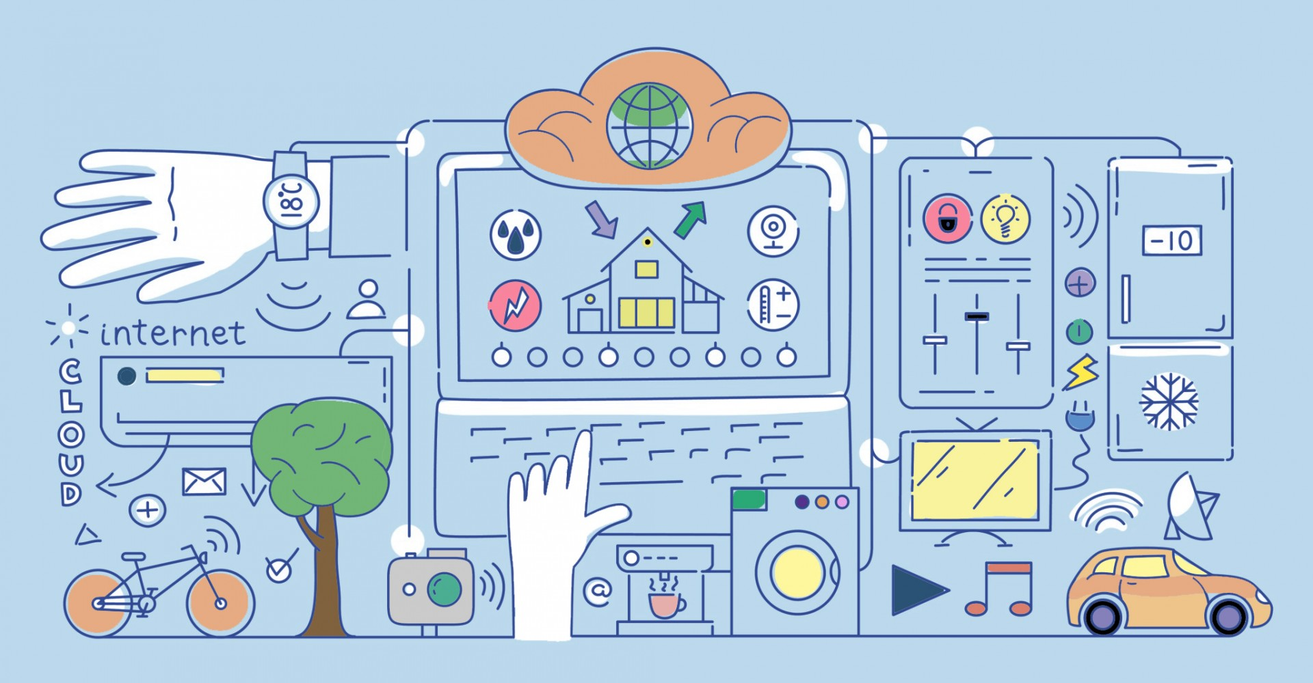
The future of IoT and the connected world
Notes:
International Data Corporation (IDC) has estimated that there will be 26 times more connected things than people in 2020 - perhaps 200 billion. This network is commonly referred to as the internet of things (IoT).
Free O’Reilly book (37 pp., PDF) - Architecting for the Internet of Things: https://voltdb.com/sm/16/IoTOReilly

Slide 31
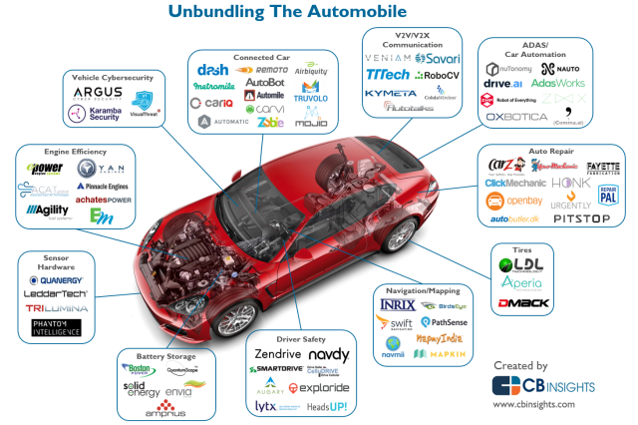
Sensors & software for the automobile
Notes:
Disrupting the Car Industry https://whatsthebigdata.com/2016/06/14/disrupting-the-car-industry/
While self-driving tech - which is included in the infographic above - receives the lion’s share of media attention, a host of less-heralded startups are targeting specific pieces of automotive infrastructure or components. For example, companies including Quanergy, LeddarTech, and TriLumina are seeking to capitalize on the self-driving revolution by dramatically lowering the cost of expensive LiDAR sensors.
Startups such as Veniam and Savari are developing vehicle-to-vehicle (V2V) and vehicle-to-anything (V2X) communications, another autonomous-adjacent technology field. With increasing automotive connectivity seemingly inevitable, vehicle cybersecurity has also begun to emerge as a focus, with newer players like Karamba Security joining others such as Argus Cyber Security.

Slide 32
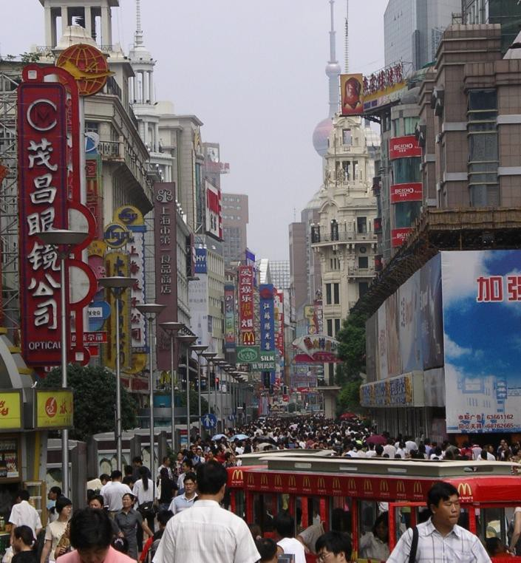
Technology & tomorrow: Future directions (IEEE)
IEEE New Technologies Connections is a resource to emerging technologies:
Big Data
Brain
Cybersecurity Initiative
Digital Senses
Green ICT
Internet of Things (IoT)
Rebooting Computing
Smart Cities
Smart Materials
Software Defined Networks (SDN)
Cloud Computing
Life Sciences
Smart Grid
Transportation Electrification
www.ieee.org/about/technologies
Notes:
The Institute of Electrical and Electronics Engineers (IEEE) recommends getting involved in their current Future Directions Initiatives:
Big Data - Big data is much more than just data bits and bytes on one side and processing on the other. IEEE, through its Cloud Computing Initiative and multiple societies, has already been taking the lead on the technical aspects of big data. To provide increased value, IEEE will provide a framework for collaboration throughout IEEE. IEEE has launched a new initiative focused on big data. Plans are under way to capture all the different perspectives via in-depth discussions, and to drive to a set of results that will define the scope and the direction for the initiative.
Brain - This initiative is dedicated to advancing technologies that improve the understanding of brain function, revolutionizing current abilities to reverse engineer neural circuits in both the central and peripheral nervous systems, and developing new approaches to interface the brain with machines for augmenting human-machine interaction and mitigating effects of neurological disease and injury.
Cybersecurity Initiative - Through outreach projects, workshops, experiments, and challenge competitions, the IEEE Cybersecurity Initiative builds on IEEE’s long-standing and world-leading technical activities in cybersecurity and privacy to actively engage, inform, and support members, organizations, and communities involved in cybersecurity research, development, operations, policy, and education.
Digital Senses - IEEE Digital Senses Initiative is dedicated to advancing technologies that capture and reproduce, or synthesize the stimuli of various senses (sight, hearing, touch, smell, taste, etc.), combine the reproduced or synthesized stimuli with the naturally received stimuli in various ways, and help humans or enable machines to perceive, understand, and respond to the stimuli. Plans are under way to capture all the different perspectives via in-depth cross-disciplinary discussions, and to drive to a set of results that will facilitate disruptive innovations and foster cross-industry collaborations globally in three focus areas (virtual reality, augmented reality, and human augmentation) and many other relevant areas (wearables, consumer healthcare, smart robots, etc.).
Green ICT - Green Information and Communications Technology is a key driver of sustainability when green metrics (energy consumption, atmospheric emissions, e-waste, life cycle management) are effectively coupled with its positive socio-economic impacts. IEEE is focused on achieving sustainability through greening ICT and promoting its awareness.
Internet of Things (IoT) - IoT is a self-configuring and adaptive system consisting of networks of sensors and smart objects whose purpose is to interconnect "all" things, including everyday and industrial objects, in such a way as to make them intelligent, programmable, and more capable of interacting with humans.
Rebooting Computing - IEEE seeks to rethink the computer, "from soup to nuts," including all aspects from device to user interface. This group works from a holistic viewpoint, taking into account evolutionary and revolutionary approaches.
Smart Cities - IEEE experts will work with local government leaders and city planners around the world to explore the issues and address what's needed to prepare for the ever-increasing urban population growth, including engaging and interacting with local inhabitants to increase awareness of their urban environment, leading to the formation of smart cities.
Smart Materials - These are responsive to their environment (passive) and/or external stimuli (active) in such a way that they serve an enabling technological function. Examples include, but are of course not limited to: shape memory alloys, piezoelectrics, electro/photo/thermo-chromics, self-healing polymers, magnetics, re-configurable devices/components, and many others. There is an opportunity to collaboratively connect people across the current materials and/or application focus, to address common issues that may center around phenomenology, reliability, integration, adoption and standards, or any number of others.
Software Defined Networks (SDN) - SDN and NFV (Network Functions Virtualization) are creating the conditions to reinvent network architectures. This is happening first at the edge of the network where "intelligence" has already started migrating, and where innovation is more urgently needed to overcome the "ossification" by improving networks and services infrastructure flexibility.
These initiatives have reached maturity after following through a full life cycle within Future Directions. Visit their web portals to continue to participate and learn about new volunteer opportunities.
Cloud Computing - This has become a scalable service consumption and delivery platform in the modern IT infrastructure. IEEE is advancing the understanding and use of the cloud computing paradigm, which currently has a significant impact on the entire information and communications ecosystem.
Life Sciences - The overall objective is to make IEEE a major and recognized player in the life sciences, in particular in the disciplines that are at the intersection between the organization's traditional fields-electrical engineering, computer engineering, and computer science-and the life sciences.
Smart Grid - The "smart grid" has come to describe a next-generation electrical power system that is typified by the increased use of communications and information technology in the generation, delivery, and consumption of electrical energy.
Transportation Electrification: IEEE seeks to accelerate the development and implementation of new technologies for the electrification of transportation which is manifested in the electric vehicles (EV) of today and the future.

Slide 33
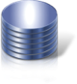



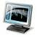

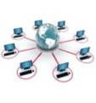
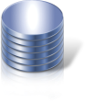
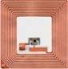
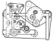






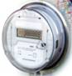



An example of a big data platform in practice (IBM)
Ingestion and Real-time Analytic Zone
Analytics and Reporting Zone
Streaming Data
Warehousing Zone
BI & Reporting
Enterprise Warehouse
Predictive
Analytics
Connectors
Hadoop
MapReduce
Hive/HBase
Col Stores
Data Marts
Visualization & Discovery
Documents
in variety of formats
ETL, MDM, Data Governance
Landing and Analytics Sandbox Zone
Metadata and Governance Zone
Notes:
We will see that other vendors (e.g., Hortonworks) offer their own Big Data Platforms that handle both real-time (streaming) and batch (traditional Hadoop v1) processing environments.
We should note that the traditional data processing environments are not going to go away:
Relational databases
Datawarehouses
…
but those will be transformed.

Slide 34
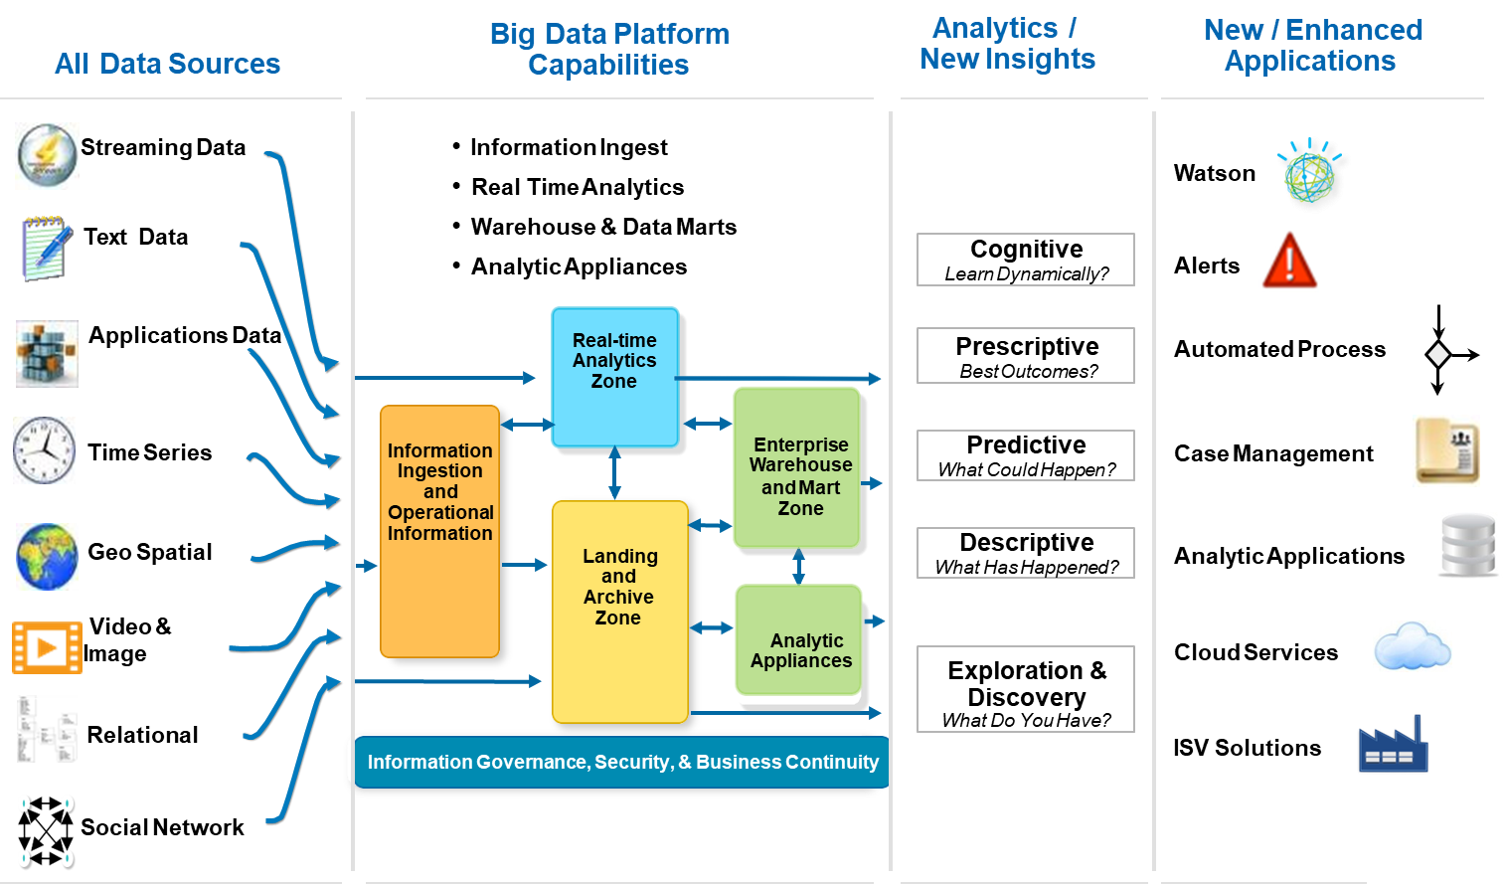
Big Data & Analytics architecture - A broader picture
Notes:
This illustration adds a series of new / enhanced applications and is more specific as to the nature of the types of data sources.

Slide 35
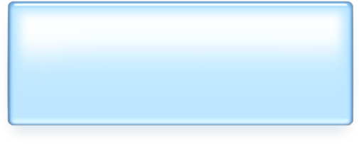


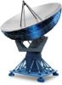






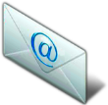
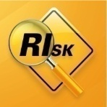
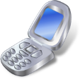
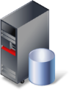

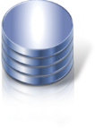
Big Data scenarios span many industries
Multi-channel customer sentiment and experience analysis
Detect life-threatening conditions at hospitals in time to intervene
Predict weather patterns to plan optimal wind turbine usage, and optimize capital expenditure on asset placement
Make risk decisions based on real-time transactional data
Identify criminals and threats from disparate video, audio, and data feeds
Notes:
Graphic: IBM

Slide 36
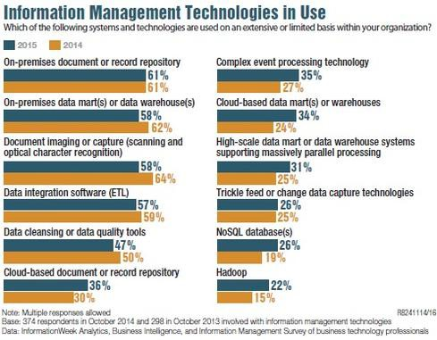
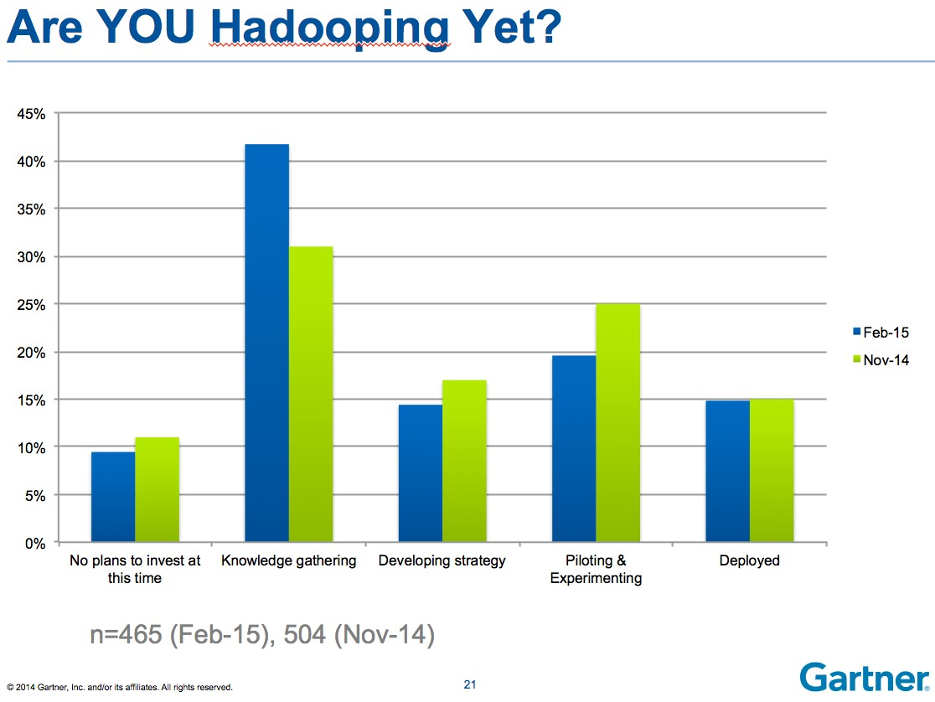
Big Data adoption (emphasis on Hadoop)

Slide 37
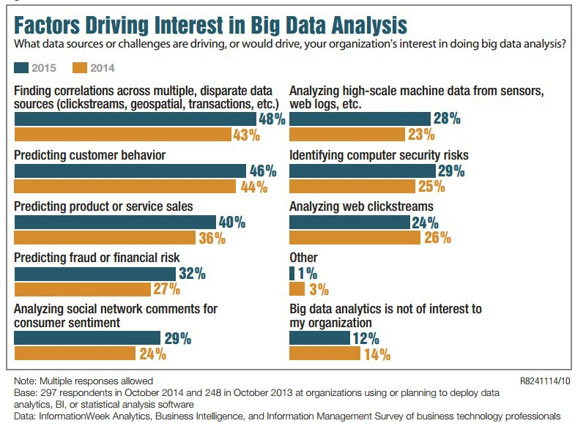
Factors driving interest in Big Data Analysis

Slide 38
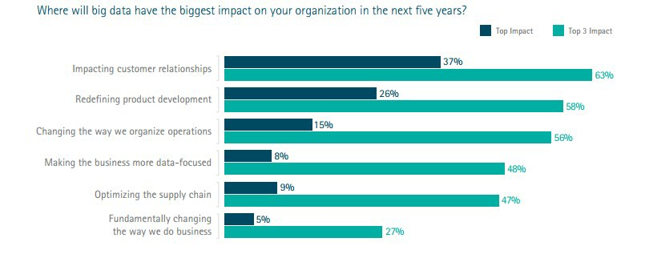
Impact of Big Data analytics in the next 5 years

Slide 39
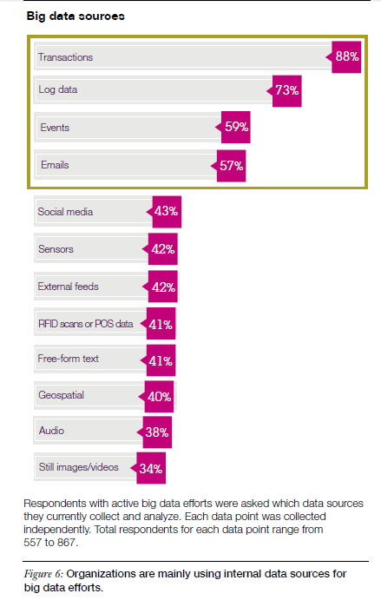
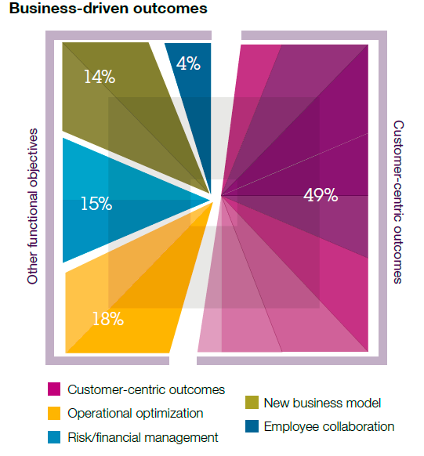
Big Data: Outcomes & data sources

Slide 40
Data & Data Science
The direction of this course is to head towards a study of Data Science - and that means we will have to study the nature of data, including how it is found, what formats it occurs in, wrangling it, …
During the journey we will study:
The basics of the technology: Hadoop & HDFS, MapReduce & YARN, Spark
Data formats & data movement
The role & work of the Data Scientist
Programming for Big Data
The Hadoop ecosystem - both open source and proprietary approaches
Data governance & data security
Notes:
The sections of this course are:
0. Orientation & Introduction to Big Data
Hadoop & HDFS
MapReduce & YARN
Spark
Data Formats & Data Movement
The Role & Work of the Data Scientist
Programming for Big Data
The Hadoop Ecosystem
Data Governance & Data Security

Slide 41
Facets of data
In data science and big data, you will come across many different types of data, and each of them require different tools and techniques. The main categories of data are:
Structured
Unstructured
Natural language
Machine-generated
Graph-based
Audio, video, and image
Streaming
Cielen, D., Meysman, A. D. B., & Ali, M. (2016). Introducing data science: Big data, machine learning, and more, using Python tools. Shelter Island, NY: Manning Publications, pp. 4-8.
Notes:
We live in the data age. It’s not easy to measure the total volume of data stored electronically, but an IDC estimate put the size of the “digital universe” at 4.4 zettabytes in 2013 and is forecasting a tenfold growth by 2020 to 44 zettabytes. A zettabyte is 10²¹ bytes, or equivalently one thousand exabytes, one million petabytes, or one billion terabytes. That’s more than one disk drive for every person in the world.
- White, T. (2015). Hadoop: The definitive guide (4th, revised & updated ed.). Sebastopol, CA: O'Reilly Media, p. 1.
For the meaning of this terminology (terabyte, petabyte, exabyte, zettabyte), see the next slide and its notes.
This flood of data is coming from many sources. Consider the following:
The New York Stock Exchange generates about 4−5 terabytes of data per day.
Facebook hosts more than 240 billion photos, growing at 7 petabytes per month.
Ancestry.com, the genealogy site, stores around 10 petabytes of data.
The Internet Archive stores around 18.5 petabytes of data.
(All figures are from 2013 or 2014. For more information, see Tom Groenfeldt, “At NYSE, The Data Deluge Overwhelms Traditional Databases”; Rich Miller, “Facebook Builds Exabyte Data Centers for Cold Storage”; Ancestry.com’s “Company Facts”; Archive.org’s “Petabox”; and the Worldwide LHC Computing Grid project’s welcome page.)

Slide 42
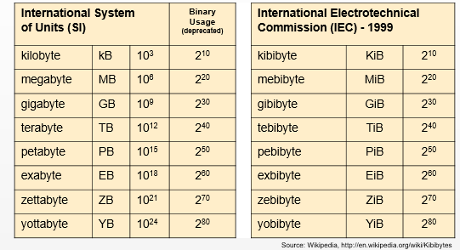
System of Units / Binary System of Units
Notes:
When we talk about Big Data, we need to have some measuring units. Accuracy in terminology is important.
Please note that international symbol for kilo is small “k” (and not capital “K”) - and thus kB. This is a common mistake in usage.
The easiest way to remember some of this: 1 petabyte = 1000 terabytes, 1 exabyte = 1 billion gigabytes, 1 zettabyte = 1 billion terabytes.
You need to be aware of the two nomenclatures for sizing disk and storage media: the official International System of Units (SI) and the now deprecated binary usage, based on powers of 2.
Unfortunately, both are in use in all the literature, and usually without distinction.
From an operating systems perspective, Linux and OS X compute in powers of 10 (1KB = 1000 Bytes), Windows (even in Windows 10) use powers of 2 (1KB = 1024 Bytes).
Disk and tape storage is generally storage is universally sold as powers of 10, but called GB, TB, etc. Thus a purchased 4 TB disk drive is truly 4*10¹²) and will appear at 3.57 TB on Windows (really 4 TiB = 3.57 * 2⁴⁰).
Note also that the correct formulation is kB (kilo is lowercase “k” in SI terminology), etc.
Be very careful when talking about network speed, as this is fairly standard:
1 Mbps = one million bits per second
1 MBps = one million bytes per second
By the way, even the term “byte” is a little ambiguous. The generally accepted meaning these days is an octet (i.e., eight bits).
The de facto standard of eight bits is a convenient power of two permitting the values 0 through 255 for one byte. The international standard IEC 80000-13 codified this common meaning. Many types of applications use information representable in eight or fewer bits and processor designers optimize for this common usage. The popularity of major commercial computing architectures has aided in the ubiquitous acceptance of the 8-bit size. The unit octet was defined to explicitly denote a sequence of 8 bits because of the ambiguity associated at the time with the byte.
- https://en.wikipedia.org/wiki/Byte
Unicode UTF-8 encoding is variable-length and uses 8-bit code units. It was designed for backward compatibility with ASCII and to avoid the complications of endianness and byte order marks in the alternative UTF-16 and UTF-32 encodings. The name is derived from: Universal Coded Character Set + Transformation Format - 8-bit. UTF-8 is the dominant character encoding for the World Wide Web, accounting for 86.9% of all Web pages in May 2016. The Internet Mail Consortium (IMC) recommends that all e-mail programs be able to display and create mail using UTF-8, and the W3C recommends UTF-8 as the default encoding in XML and HTML. UTF-8 encodes each of the 1,112,064 valid code points in the Unicode code space (1,114,112 code points minus 2,048 surrogate code points) using one to four 8-bit bytes (a group of 8 bits is known as an octet in the Unicode Standard).
- https://en.wikipedia.org/wiki/UTF-8

Slide 43

Introduction to Hadoop & the Hadoop Ecosystem
Why? When? Where?
Origins / History
The Why of Hadoop
The When of Hadoop
The Where of Hadoop
Hadoop Basics
Comparison with RDBMS
Hadoop architecture
MapReduce
HDFS
Hadoop Common
Notes:
So let’s dive in now to the topic of Hadoop and the Hadoop Ecosystem.
We will look at cover the big picture first, diving in just so far - in this units - to get our feet wet. Later on, in the follow up units, we will more deeply into BigInsights itself, and explore how it fits into a broader IT environment that could involve data warehouses, relational DBMSs, streaming engines, etc. Then I’ll wrap up by explaining what IBM can do to help you get started with this technology.
https://gigaom.com/2013/03/04/the-history-of-hadoop-from-4-nodes-to-the-future-of-data/2/

Slide 44
What is Hadoop?
Apache open source software framework for reliable, scalable, distributed computing of massive amount of data
Hides underlying system details and complexities from user
Developed in Java
Consists of 3 sub projects:
MapReduce
Hadoop Distributed File System (aka. HDFS)
Hadoop Common
Has a large ecosystem with both open-source & proprietary Hadoop-related projects
Hbase / Zookeeper / Avro / etc.
Meant for heterogeneous commodity hardware
Notes:
Hadoop is an open source project of the Apache Foundation.
It is a framework written in Java originally developed by Doug Cutting who named it after his son's toy elephant.
Hadoop uses Google’s MapReduce and Google File System (GFS) technologies concepts at its foundation.
It is optimized to handle massive amounts of data which could be structured, unstructured or semi-structured, using commodity hardware, that is, relatively inexpensive computers.
This massive parallel processing is done with great performance. In its initial conception, which we will study first, it is a batch operation handling massive amounts of data, so the response time is not immediate.
Hadoop replicates its data across different computers, so that if one goes down, the data is processed on one of the replicated computers.
You may be familiar with OLTP (Online Transactional processing) workloads where data is randomly accessed on structured data like a relational database. For example when you access your bank account.
You may also be familiar with OLAP (Online Analytical processing) or DSS (Decision Support Systems) workloads where data is sequentially access on structured data like a relational database to generate reports that provide business intelligence.
Now, you may not be that familiar with the concept of “Big Data”. Big Data is a term used to describe large collections of data (also known as datasets) that may be unstructured, and grow so large and quickly that is difficult to manage with regular database or statistics tools.
Hadoop is not used for OLTP nor OLAP, but for Big Data. It complements these two, to manage data. So Hadoop is NOT a replacement for a RDBMS.

Slide 45

A large (and growing) Ecosystem
Notes:
Some references:
https://www.coursera.org/learn/hadoop/lecture/E87sw/hadoop-ecosystem-major-components
https://hadoopecosystemtable.github.io/

Slide 46

Who uses Hadoop?
Notes:
Reference:
https://wiki.apache.org/hadoop/PoweredBy

Slide 47
Why & where Hadoop is used / not used
What Hadoop is good for:
Massive amounts of data through parallelism
A variety of data (structured, unstructured, semi-structured)
Inexpensive commodity hardware
Hadoop is not good for:
Not to process transactions (random access)
Not good when work cannot be parallelized
Not good for low latency data access
Not good for processing lots of small files
Not good for intensive calculations with little data

Slide 48

Hadoop / MapReduce timeline
Notes:
Hadoop was created by Doug Cutting, the creator of Apache Lucene, the widely used text search library. Hadoop has its origins in Apache Nutch, an open source web search engine, itself a part of the Lucene project.
Following are the major events that led to the creation of the stable version of Hadoop that's available.
2003 - Google launches project Nutch to handle billions of searches and indexing millions of web pages.
Oct 2003 - Google releases papers with GFS (Google File System)
Dec 2004 - Google releases papers with MapReduce
2005 - Nutch used GFS and MapReduce to perform operations
2006 - Yahoo! created Hadoop based on GFS and MapReduce (with Doug Cutting and team)
2007 - Yahoo started using Hadoop on a 1000 node cluster
Jan 2008 - Apache took over Hadoop
Jul 2008 - Tested a 4000 node cluster with Hadoop successfully
2009 - Hadoop successfully sorted a petabyte of data in less than 17 hours to handle billions of searches and indexing millions of web pages.
2011 - IBM releases BigInsights based on Hadoop 0.23
2011 June - Hortonworks founded in Santa Clara, CA
Dec 2011 - Hadoop releases version 1.0
Aug 2013 - Version 2.0.6 is available
A more detailed history can be found at:
- https://gigaom.com/2013/03/04/the-history-of-hadoop-from-4-nodes-to-the-future-of-data/
When the seeds of Hadoop were first planted in 2002, the world just wanted a better open-source search engine. So then-Internet Archive search director Doug Cutting and University of Washington graduate student Mike Cafarella set out to build it. They called their project Nutch and it was designed with that era’s web in mind.
Looking back on it today, early iterations of Nutch were kind of laughable. About a year into their work on it, Cutting and Cafarella thought things were going pretty well because Nutch was already able to crawl and index hundreds of millions of pages. “At the time, when we started, we were sort of thinking that a web search engine was around a billion pages,” Cutting explained to me, “so we were getting up there.”
There are now about 700 million web sites and, according to Wired’s Kevin Kelly, well over a trillion web pages.
But getting Nutch to work wasn’t easy. It could only run across a handful of machines, and someone had to watch it around the clock to make sure it didn’t fall down.
“I remember working on it for several months, being quite proud of what we had been doing, and then the Google File System paper came out and I realized ‘Oh, that’s a much better way of doing it. We should do it that way,'” reminisced Cafarella. “Then, by the time we had a first working version, the MapReduce paper came out and that seemed like a pretty good idea, too.”
Google released the Google File System paper in October 2003 and the MapReduce paper in December 2004. The latter would prove especially revelatory to the two engineers building Nutch.
“What they spent a lot of time doing was generalizing this into a framework that automated all these steps that we were doing manually,” Cutting explained.
References:
Google’s Paper on Big Table: http://research.google.com/archive/bigtable.html
Google’s Paper on MapReduce: http://research.google.com/archive/mapreduce.html

Slide 49

Many contributors to Hadoop (e.g., 2006-2011)
Notes:
The big fear is a fragmentation of Hadoop similar to what happened to the Unix operating system in the 1990s. Already, Cloudera, Hortonworks, EMC Greenplum, MapR, Intel and IBM (and, in a way, Amazon Web Services) sell foundational-level Hadoop distributions that vary from one another and from Apache Hadoop in significant ways. Facebook,Twitter, Quantcast and other web companies also do their own open source work and often release it into open source via Github.
The companies involved haven’t always done their best to quell these fears. Hortonworks and Cloudera have engaged in very public disputes over who the real open source champion is and whose employees have been more integral to the development of Apache Hadoop. And both of those companies are quick to point the finger at other companies they claim are doing Hadoop a disservice by developing proprietary software at the MapReduce and HDFS levels.

Slide 50
The two key components of Hadoop
Hadoop Distributed File System = HDFS
Where Hadoop stores data
A file system that spans all the nodes in a Hadoop cluster
It links together the file systems on many local nodes to make them into one big file system
MapReduce framework
How Hadoop understands and assigns work to the nodes (machines)
Notes:
There are two key components or aspects of Hadoop that are important to understand:
MapReduce is a software framework introduced by Google to support distributed computing on large data sets of clusters of computers.
The Hadoop Distributed File System (HDFS) is where Hadoop stores its data. This file system spans all the nodes in a cluster. Effectively, HDFS links together the data that resides on many local nodes, making the data part of one big file system. You can use other file systems with Hadoop (e.g., MapR’s MapRFS, IBM’s Spectrum Scale [formerly known as GPFS = General Parallel File System]), but HDFS is quite common.
References:
http://info.mapr.com/Hadoop_Buyers_Guide_2015.html
http://www.redbooks.ibm.com/abstracts/sg248254.html

Slide 51
Think differently
As we start to work with Hadoop, we need to think differently:
Different processing paradigms
Different approaches to storing data
Think ELT (extract-load-transform) rather than ELT (extract-transform-load)
…and to understanding the Hadoop Ecosystem is embark on a continuing learning process…self-education is an ongoing requirement

Slide 52
Core Hadoop concepts
Applications are written in high-­level language code
Work is performed in a cluster of commodity machines
Nodes talk to each other as little as possible
Data is distributed in advance
Bring the computation to the data
Data is replicated for increased availability and reliability
Hadoop is fully scalable and fault-­‐tolerant

Slide 53

Differences between RDBMS and Hadoop/HDFS

Slide 54
Requirements for this new approach
Partial Failure Support
Data Recoverability
Component Recovery
Consistency
Scalability
Hadoop is based on work done by Google in the late 1990s/early 2000s: Specifically, on papers describing the Google File System (GFS) (published in 2003), and MapReduce (published in 2004)
Notes:
Partial Failure Support
Failure of a component should result in a graceful degradation of application performance, not complete failure of the entire system
Data Recoverability
If a component of the system fails, its workload should be assumed by still-functioning units in the system - failure should not result in the loss of any data
Component Recovery
If a component of the system fails and then recovers, it should be able to rejoin the system, without requiring a full restart of the entire system
Consistency
Component failures during execution of a job should not affect the outcome of the job
Scalability
Adding load to the system should result in a graceful decline in performance of individual jobs, not failure of the system
Increasing resources should support a proportional increase in load capacity
References:
Google File System (2003), aka BigTable: http://research.google.com/archive/gfs.html
Bigtable: A Distributed Storage System for Structured Data
MapReduce (2004): http://research.google.com/archive/mapreduce.html
MapReduce: Simplified Data Processing on Large Clusters

Slide 55

Some terminology…to get you started
75 Big Data Terms Everyone Should Know (July 2017) http://dataconomy.com/2017/07/75-big-data-terms-everyone-know
But these are just the beginning of a terminological dictionary that you should develop for yourself

